Slide 1
Drinking Water Clinic Kickoff Information

Slide 2
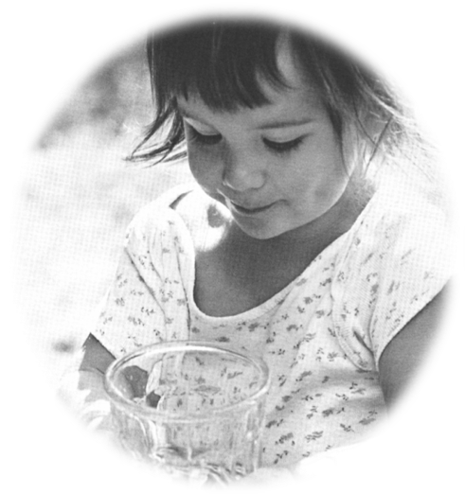
Thank you for participating! You have taken an important step towards understanding your water quality!
Source: Penn State University

Slide 3
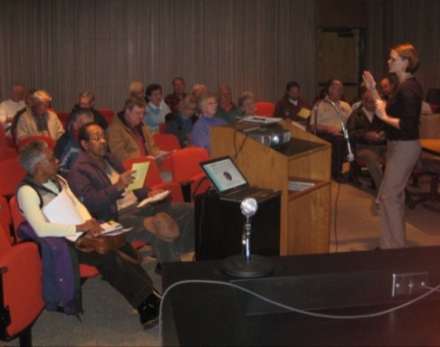
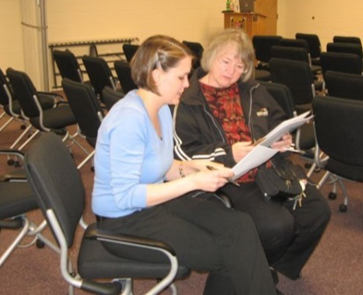
What is the VAHWQP?
Established in 1989
County-based Drinking Water Clinics
Coordinated with trained local extension educators or volunteers
Kickoff Meeting – distribute sample kits
Homeowners collect sample; samples analyzed at VT BSE lab for 14 parameters
Interpretation Meeting: test results, interpretation and basic information about maintenance and addressing problems
47,000 wells and springs analyzed across ALL Virginia counties

Slide 4
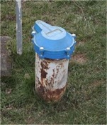
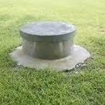
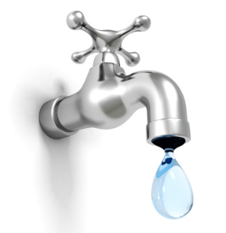
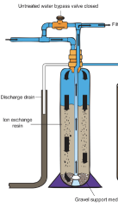
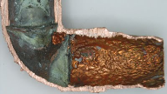
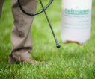
What may affect my water quality?
Well location
Well construction
Well maintenance
Hydrogeology
Water Treatment
and Plumbing
Local land uses
Surface activities
Photo credits: Penn State Univ., http://www.banthebagspdx.com/?p=283, USGS; http://www.clker.com/clipart-puzzle-pieces-2.html;
http://levahnbros.wordpress.com/2009/12/01/copper-pipe-leak/; http://www.pubs.ext.vt.edu/442/442-670/442-670.html

Slide 5
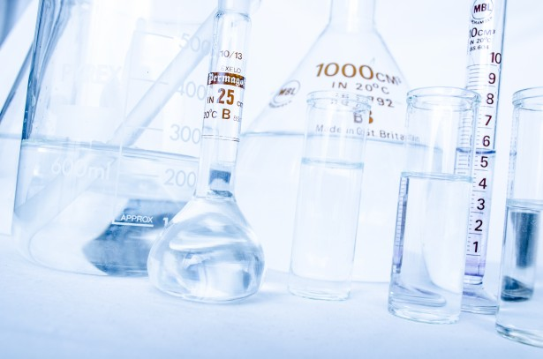
What does the analysis include?
Bacteria
Total Coliform bacteria
E. Coli bacteria
Chemicals
Nitrate
Copper
Iron
Manganese
Sulfate
Sodium
Fluoride
Lead
Arsenic
pH
Total dissolved solids
Hardness

Slide 6
Sample collection video
Notes:
https://www.youtube.com/watch?v=a2wqzuzvbK4
Available on youtube or email Erin for a downloadable version

Slide 7
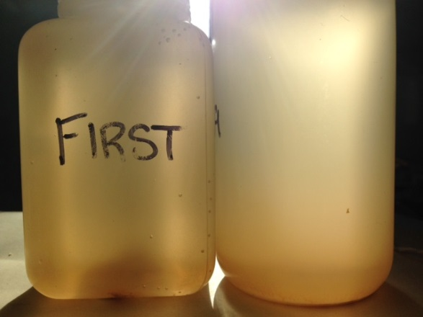
First draw vs. Flush samples…
Metals like copper and lead are not usually found in groundwater, but may be leached from pipes and other plumbing into your water.
If these metals are in your plumbing, water sitting in pipes at least 6 hours will usually have the highest levels.
The sample bottle labeled FIRST (X on top) needs to be collected first thing in the morning, before any water has been used in the home.
Important!
Do not use any water in the home after 10 pm or for 6 hours before you collect (if possible). Especially do not use water from the faucet where you plan to collect your samples (e.g., kitchen tap).
Collect the bottle labeled “FIRST” with an “X” on the top FIRST, before running any water!

Slide 8
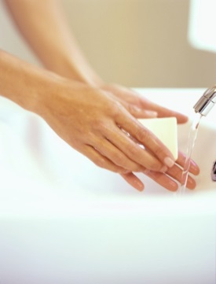
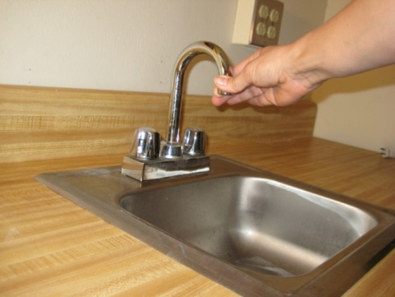
Water sample collection
Sample envelope contains:
4 bottles
Questionnaire
Sampling Instructions
Tips:
Do not use water after 10 pm the night before!
Choose a kitchen or bathroom faucet.
If you drink the water, collect there.
Make sure sink is clean and dishes are removed.
Do not remove bottle cap until you are ready to collect each sample.
Do not touch inside of sample bottle or cap.
Collect FIRST (X on top) bottle first!
Then wash hands before collecting other samples.

Slide 9
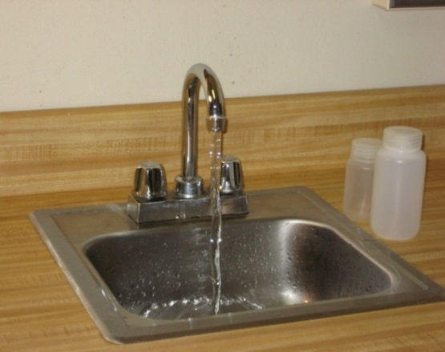
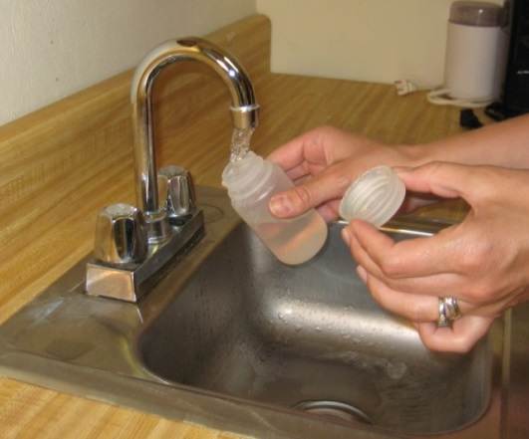
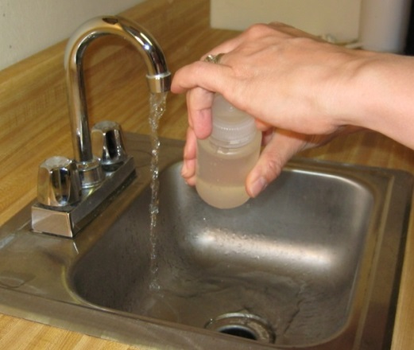
Sampling instructions
Read sample instructions completely before collecting samples.
Do not run any water in the home after 10 pm the night before collecting samples.
Before ANY water has been used in the home, collect a sample in the bottle labeled FIRST (X on top) by turning the water on fully as you would to fill a glass.
After collecting FIRST sample and replacing cap securely, wash hands thoroughly to avoid contaminating the sterile bacteria bottle. Dry hands.
Allow water to run for at least 1 minute to flush out pipes.

Slide 10
Sampling instructions (cont’d)
In any order, fill the rest of the bottles, one bottle at a time.
Carefully remove one cap, and hold it while you fill the bottle.
Fill the bottle completely; do not allow it to overflow, and leave as little air as possible. Replace and tighten cap securely.
Repeat with remaining two bottles.
If you are not immediately going to drop off your sample, put in refrigerator or cooler.
Complete the questionnaire and bring it with you to the drop off site!

Slide 11
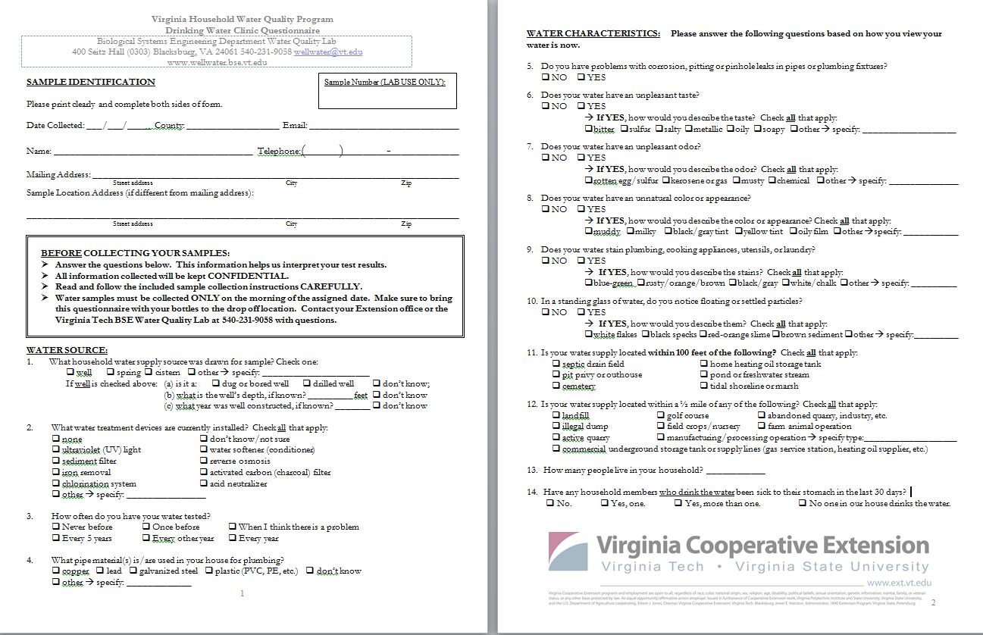
Complete the questionnaire!
PLEASE KEEP QUESTIONNAIRE DRY AND SEPARATE FROM BOTTLES.

Slide 12
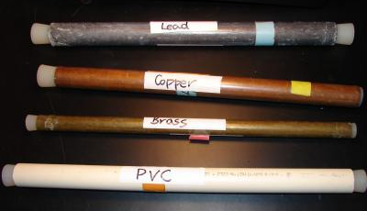
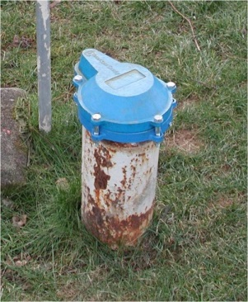
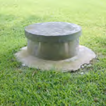
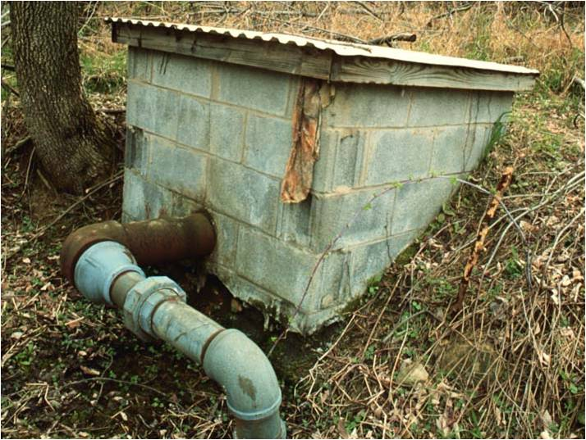
Well and plumbing system questions…
Piping Material*
Lead
Copper
Brass
Plastic
Type of PLUMBING MATERIAL(S)*
Type of Water System*
Drilled Well
Bored Well
Spring Box
*Answer to the best of your knowledge. Some well casings are buried and not visible from the surface. More than one type of plumbing materials is common – list all that you can see.

Slide 13
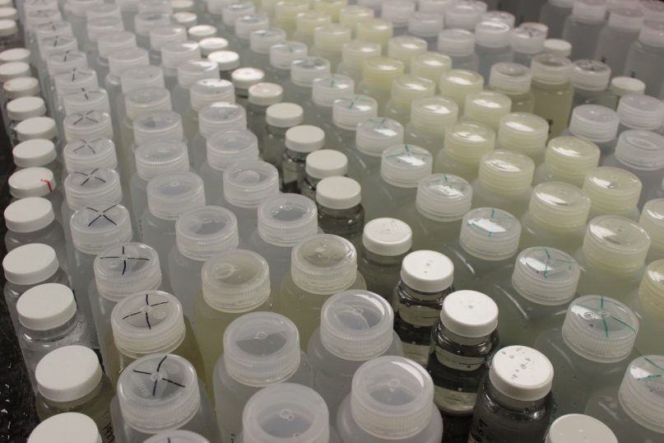
SAMPLE COLLECTION DAY (ADD DATE, LOCATION, TIME HERE) NOTE: SAMPLES WILL ONLY BE COLLECTED ON THIS DAY!

Slide 14
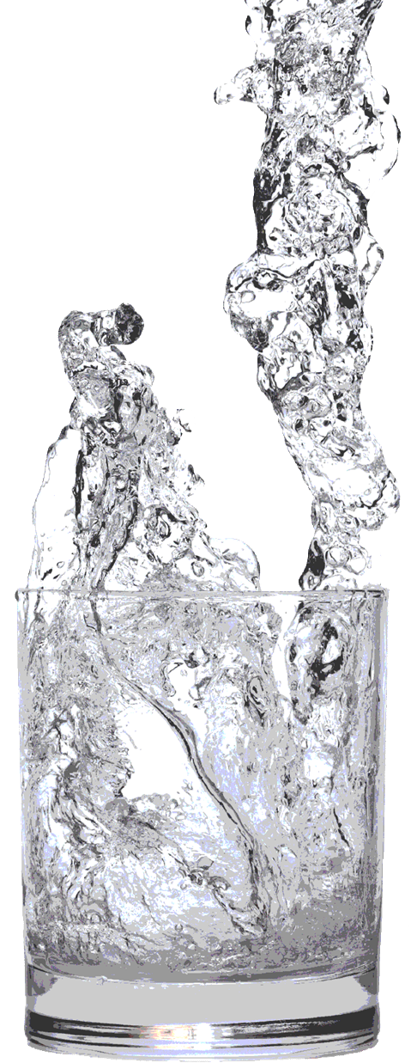
For more information about private water supplies and the program, please visit: www.wellwater.bse.vt.edu
Questions?
Erin Ling
State Coordinator
wellwater@vt.edu
Virginia Cooperative Extension is a partnership of Virginia Tech, Virginia State University, the U.S. Department of Agriculture, and local governments. Its programs and employment are open to all, regardless of age, color, disability, sex (including pregnancy), gender, gender identity, gender expression, genetic information, ethnicity or national origin, political affiliation, race, religion, sexual orientation, or military status, or any other basis protected by law.

